Slide 1

Computer Networks
CET2005B
School of Computer Engineering and Technology (SCET)

Slide 2

Unit V : Application Layer

Slide 3
Contents
Hypertext Transfer Protocol (HTTP)
Domain Name System (DNS)
Dynamic Host Control Protocol (DHCP)
Simple Mail Transfer Protocol:
POP3 (Post Office Protocol 3),
IMAP(Internet Message Access Protocol),
MIME (Multipurpose Internet Mail Extension )
File Transfer Protocol (FTP)
TELNET
Simple Network Management Protocol (SNMP)

Slide 4
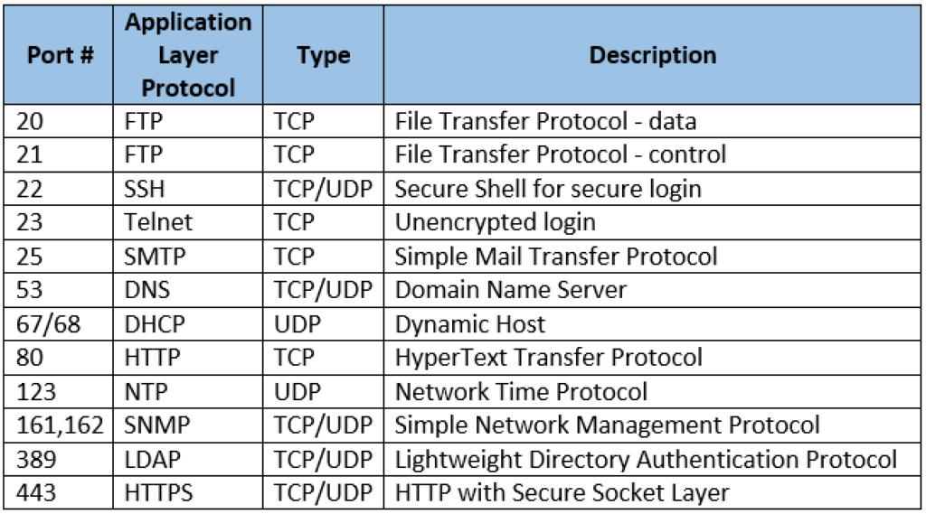
Port numbers :Application layer protocols

Slide 5
Hypertext Transfer Protocol (HTTP)
HTTP stands for HyperText Transfer Protocol.
It is a protocol used to access the data on the World Wide Web (www).
The HTTP protocol can be used to transfer the data in the form of plain text, hypertext, audio, video, and so on.
This protocol is known as HyperText Transfer Protocol because of its efficiency that allows us to use in a hypertext environment where there are rapid jumps from one document to another document.
Connectionless protocol: HTTP is a connectionless protocol.
HTTP client initiates a request and waits for a response from the server.
When the server receives the request, the server processes the request and sends back the response to the HTTP client after which the client disconnects the connection.
The connection between client and server exist only during the current request and response time only.

Slide 6
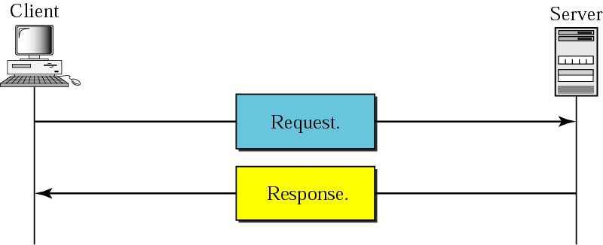
Hypertext Transfer Protocol (HTTP)
The Hypertext Transfer Protocol (HTTP) is a protocol used mainly to access data on the World Wide Web.
HTTP layered over bidirectional byte stream:
Almost always use TCP
Interaction:
Client sends request to server, followed by response from server to client
Requests/responses are encoded in text
Stateless:
Server maintains no information about past client requests
HTTP uses the services of TCP on well-known port 80

Slide 7
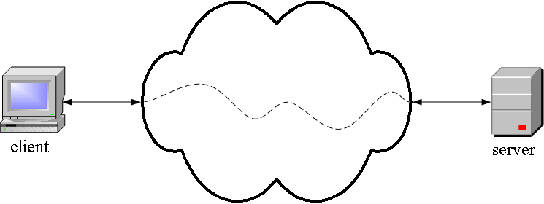
Hypertext Transfer Protocol (HTTP)
HTTP is an application layer protocol
The Web client and the Web server are application programs.
Application layer programs do useful work like retrieving Web pages, sending and receiving email or transferring files.

Slide 8
Hypertext Transfer Protocol (HTTP)
Lower layers take care of the communication details
In Application Layer: The client and server send messages and data without knowing anything about the communication network.

Slide 9
HTTP Transaction
HTTP uses the services of TCP
HTTP itself is a stateless protocol, which means that the server does not keep information about the client.
The client initializes the transaction by sending a request. The server replies by sending a response.

Slide 10
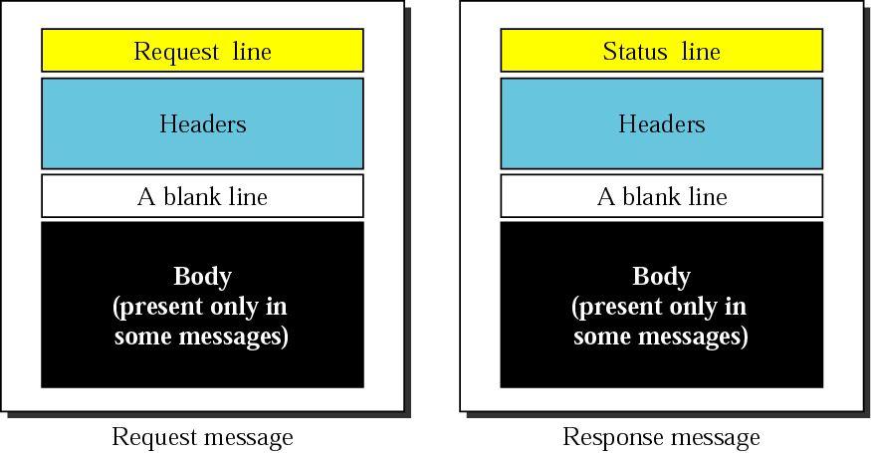
HTTP request and response messages
Figure: HTTP request and response message format

Slide 11
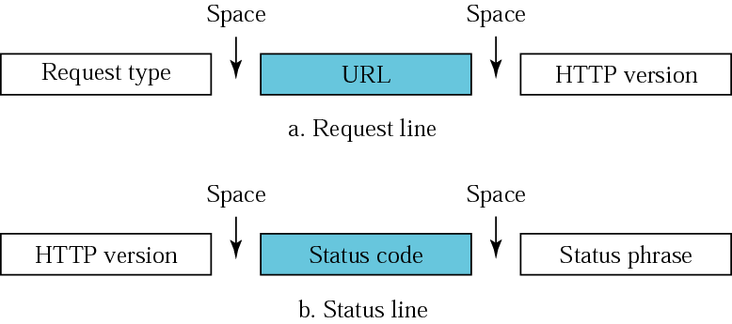
HTTP Request and Status line
An HTTP Request and Response/status is divided into three parts:
HTTP Request Type:, GET, PUT, POST, HEAD or OPTIONS)
HTTP/0.9, HTTP/1.0, HTTP/1.1, and HTTP/2.0.
status code of 200 (OK).
Figure: HTTP request and status line

Slide 12
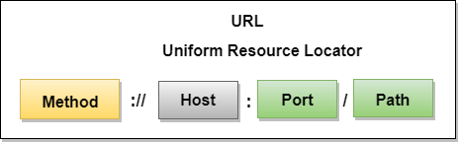
Uniform Resource Locator (URL)
A client that wants to access the document in an internet needs an address and to facilitate the access of documents, the HTTP uses the concept of Uniform Resource Locator (URL).
The Uniform Resource Locator (URL) is a standard way of specifying any kind of information on the internet.
The URL defines four parts: method, host computer, port, and path.

Slide 13
Uniform Resource Locator (URL)
Method: The method is the protocol used to retrieve the document from a server. For example, HTTP.
Host: The host is the computer where the information is stored, and the computer is given an alias name. Web pages are mainly stored in the computers and the computers are given an alias name that begins with the characters "www". This field is not mandatory.
Port: The URL can also contain the port number of the server, but it's an optional field. If the port number is included, then it must come between the host and path and it should be separated from the host by a colon.
Path: Path is the pathname of the file where the information is stored. The path itself contain slashes that separate the directories from the subdirectories and files.

Slide 14
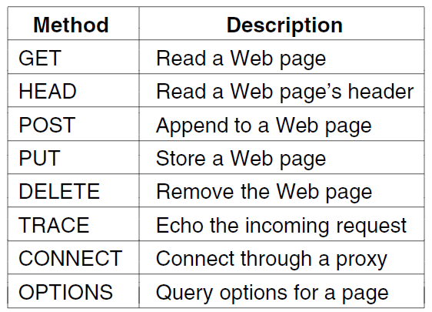
Built-in HTTP Request Methods/Commands
Figure : Built-in HTTP request methods

Slide 15
Built-in HTTP request methods
GET: The HTTP GET method is used to read (or retrieve) a representation of a resource. GET returns a representation in JSON and an HTTP response status code of 200 (OK). In an error case, it most often returns a 404 (NOT FOUND) or 400 (BAD REQUEST).
HEAD: HEAD is Same as GET, but transfers the status line and header section only.
POST: The POST method is most often utilized to create new resources. In particular, it is used to create subordinate resources. That is subordinate to some other (e.g. parent) resource.
PATCH: PATCH is used to modify resources. The PATCH request only needs to contain the changes to the resource, not the complete resource.
Figure : Built-in HTTP request methods

Slide 16
Built-in HTTP request methods
PUT: PUT Replaces all current representations of the target resource with the uploaded content.
DELETE: DELETE is quite easy to understand. It is used to delete a resource identified by filters or ID. On successful deletion, the HTTP response status code 204 (No Content) returns with no response body.
TRACE: TRACE Performs a message loop-back test along the path to the target resource.
CONNECT: CONNECT Establishes a tunnel to the server identified by a given URI.
OPTIONS: OPTIONS Describes the communication options for the target resource.
Figure : Built-in HTTP request methods

Slide 17
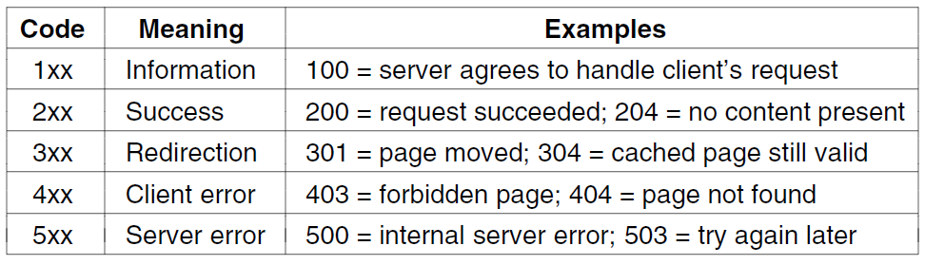
HTTP Status Code response groups
Status codes are issued by a server in response to a client's request made to the server.
The first digit of the status code specifies one of Five standard classes of responses.
The Internet Assigned Numbers Authority (IANA) maintains the official registry of HTTP status codes
Figure : HTTP status code response groups

Slide 18
HTTP status code response groups cont
1xx: informational response – the request was received, continuing process
2xx: successful – the request was successfully received, understood, and accepted
3xx: redirection – further action needs to be taken in order to complete the request
4xx: client error – the request contains bad syntax or cannot be fulfilled
5xx: server error – the server failed to fulfil an apparently valid request

Slide 19
HTTP connection
HTTP Connections
Non-Persistent
Persistent
RTT stands for the round-trip time taken for an object request and then its retrieval. In other words, it is the time taken to request the object from the client to the server and then retrieve it from the server back to the client.

Slide 20
HTTP connection
Non-persistent
The non-persistent connection takes a total time of 2RTT + file transmission time.
It takes the first RTT (round-trip time) to establish the connection between the server and the client.
he second RTT is taken to request and return the object. This case stands for a single object transmission.
After the client receives the object in non-persistent, the connection is immediately closed.
The persistent connection ensures the transfer of ​multiple objects over a single connection.

Slide 21
HTTP connection
Persistent
A persistent connection takes 1 RTT for the connection and then transfers as many objects, as wanted, over this single connection.
In persistent connections, the server leaves the connection open after sending a response.
TCP keep-alive packets are sent to maintain the connection and prevent it from timing out.
Subsequent HTTP messages between the server and clients are sent over this open connection.

Slide 22
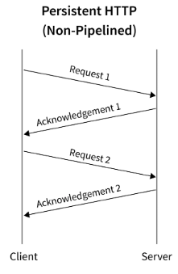
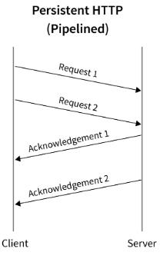
HTTP connection
A persistent HTTP connection can be either Non-pipelined or Pipelined.
Non-Pipelined
A non-pipelined HTTP connection is a connection in which, the client can send a request to the server only if the previous request that was sent by the client has been acknowledged by the server.
Pipelined
A pipelined HTTP connection is a connection in which, the client can send a request to the server even if the previous request that was sent by the client has not been acknowledged by the server.

Slide 23
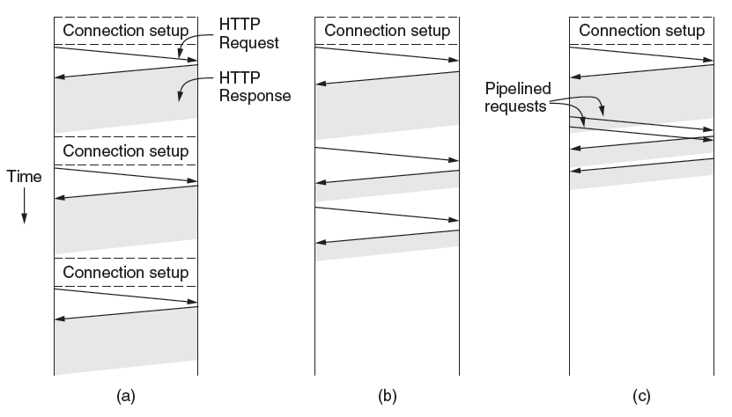
HTTP connections and requests
Figure : HTTP with (a) Multiple connections and sequential requests.
(b) A persistent connection and sequential requests.
(c) A persistent connection and pipelined requests.

Slide 24
Difference between HTTP non-persistent and persistent connection
Non-persistent Connection | Persistent Connection
In a non-persistent connection, one TCP connection is made for each request/response. | The server leaves the connection open for more requests after sending a response.
HTTP version 1.0. The client opens a TCP connection and sends a request. The server sends the response and closes the connection. | HTTP version 1.1 specifies a persistent connection by default.
The client reads the data until it encounters an end-of-file marker; it then closes the Connection. | Server can close the connection at the request of a client or if a time-out has been reached.
Ex. IRCTC, Banking (Terminate connection after closing application) | Ex. Gmail (connection Remain present even closing application)

Slide 25
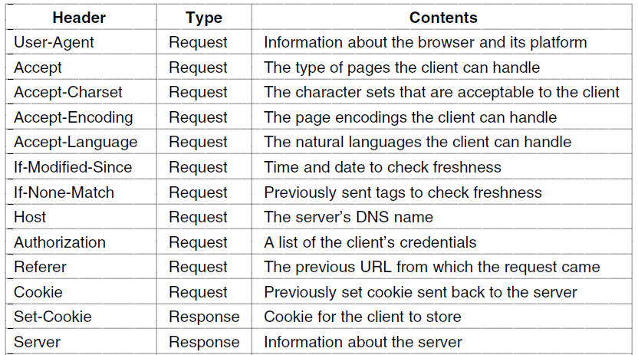
HTTP Message Headers: Extra
HTTP header fields are a list of strings sent and received by both the client program and server on every HTTP request and response. These headers are usually invisible to the end-user and are only processed or logged by the server and client applications.

Slide 26
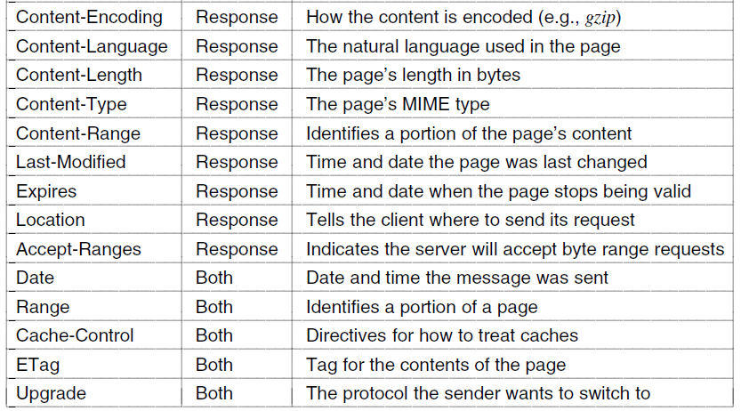
HTTP message headers

Slide 27
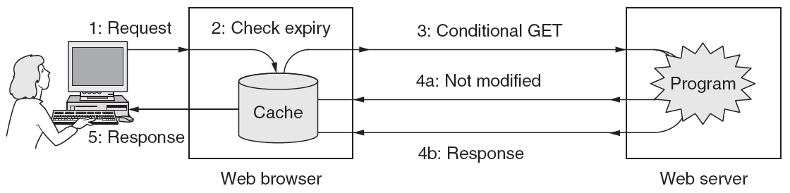
HTTP Caching
Caching is a technique that stores a copy of a given resource and serves it back when requested. When a web cache has a requested resource in its store, it intercepts the request and returns a copy of the stored resource instead of redownloading the resource from the originating server.
The HTTP Cache is an effective way to improve load performance because it reduces unnecessary network requests.
Figure : HTTP caching

Slide 28
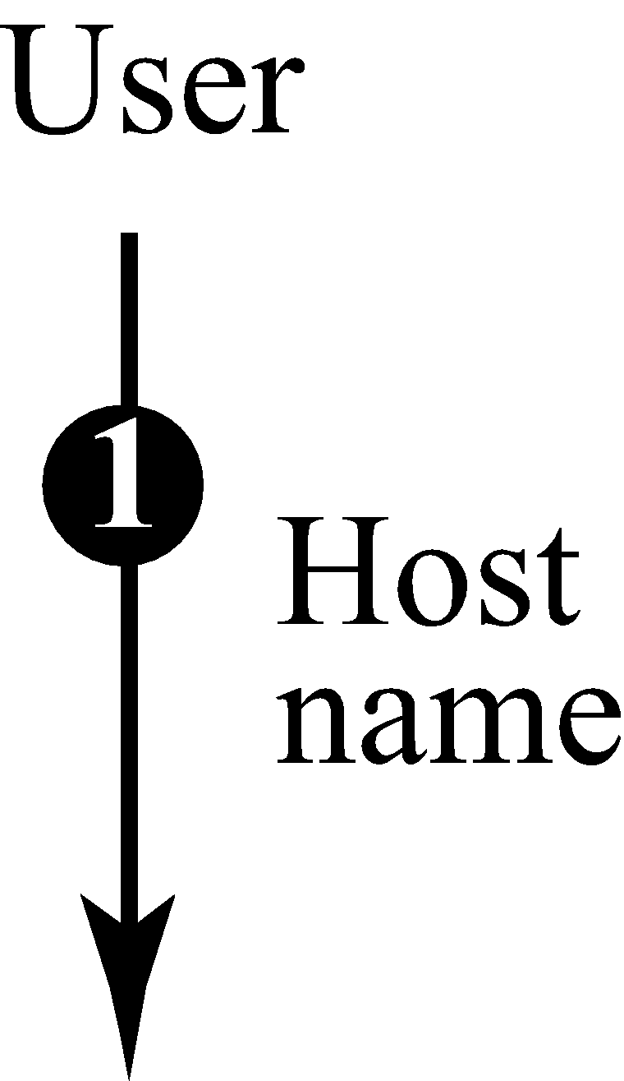
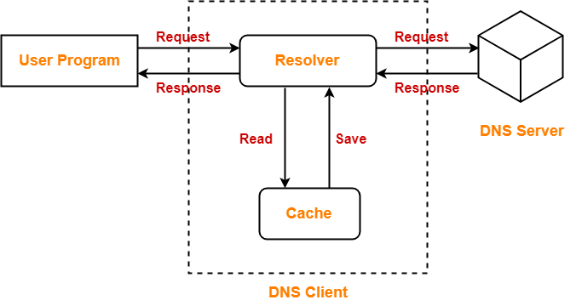
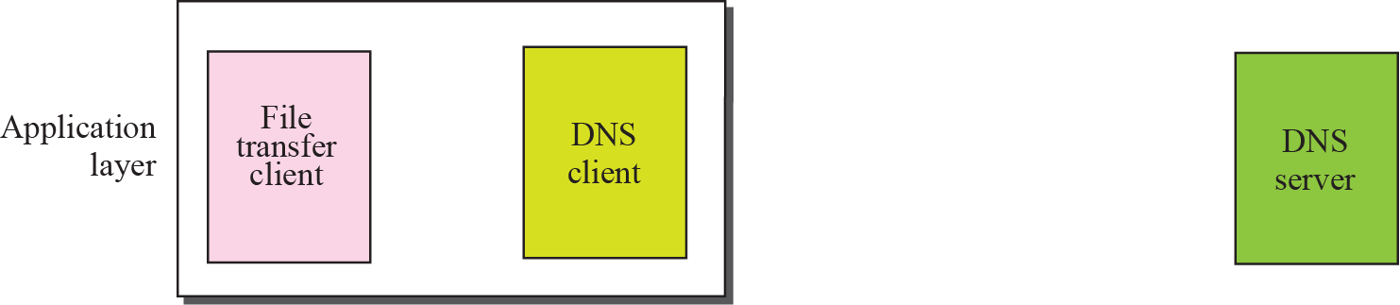
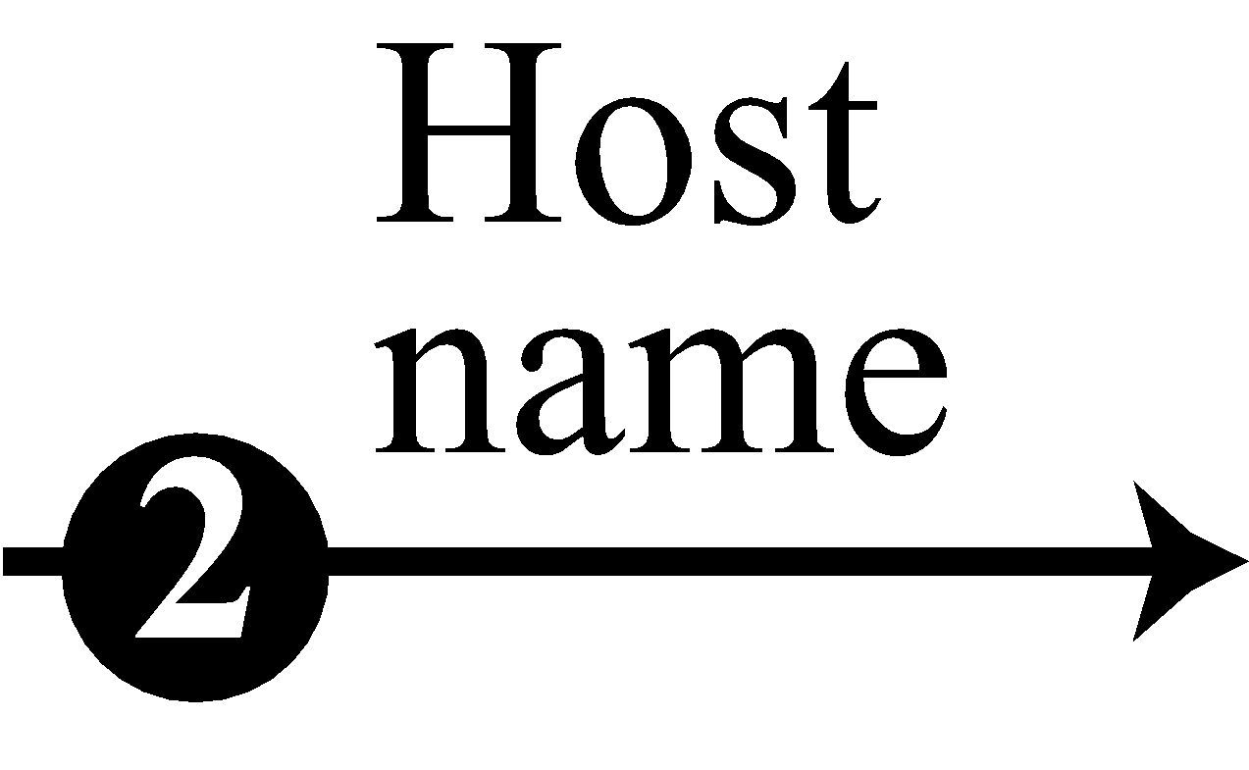
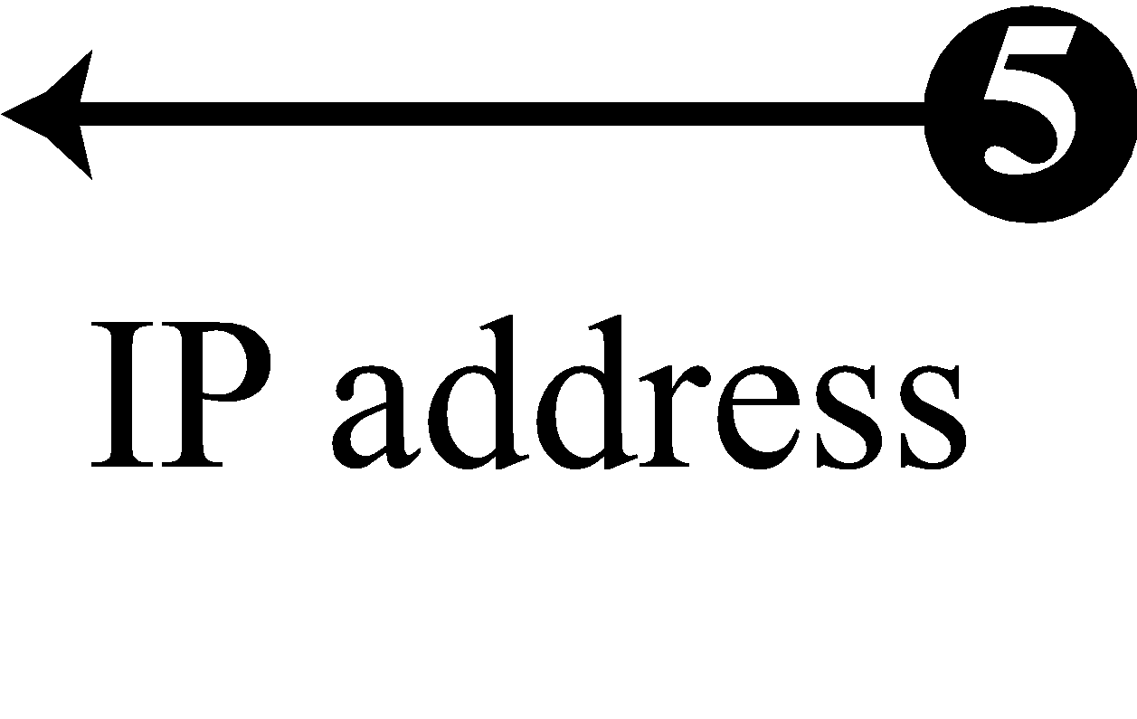
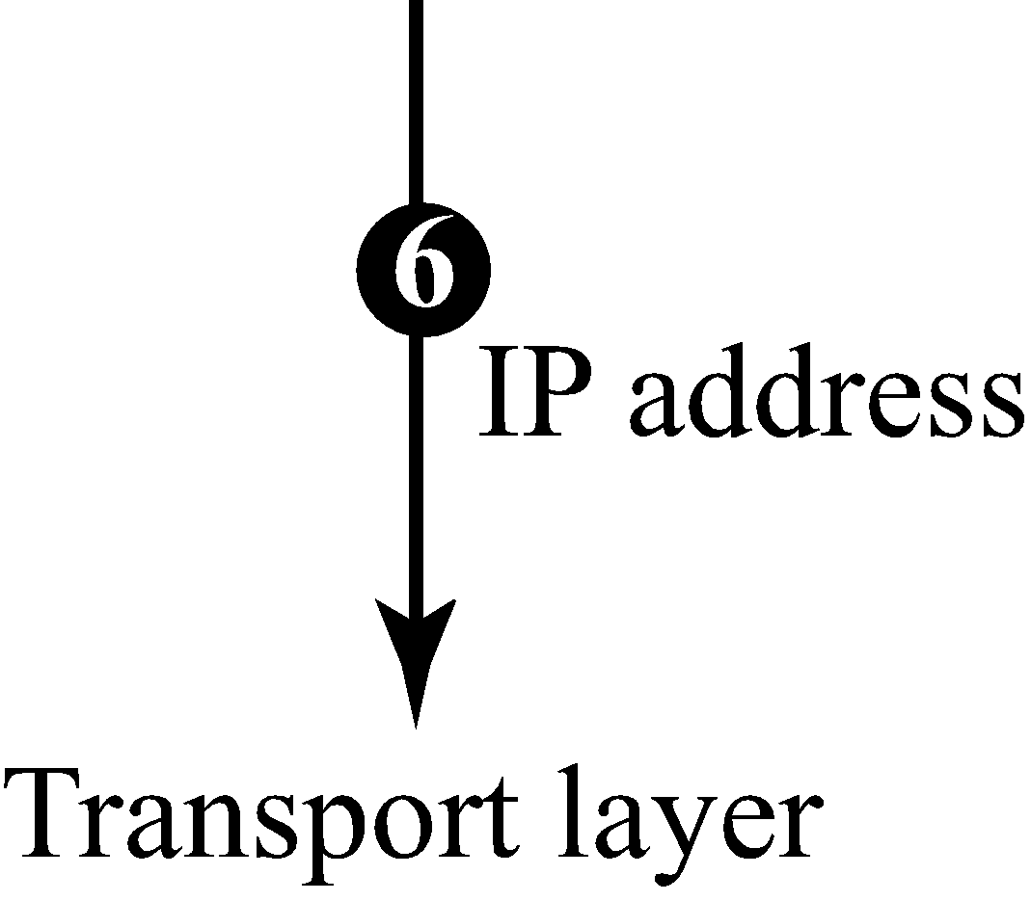
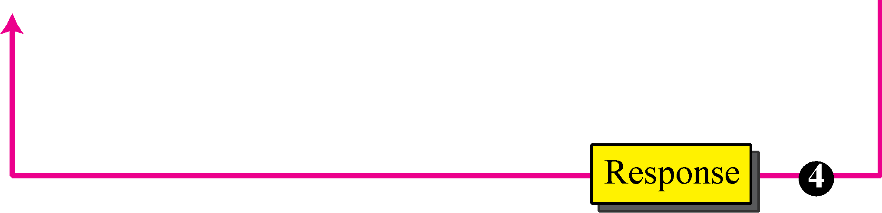
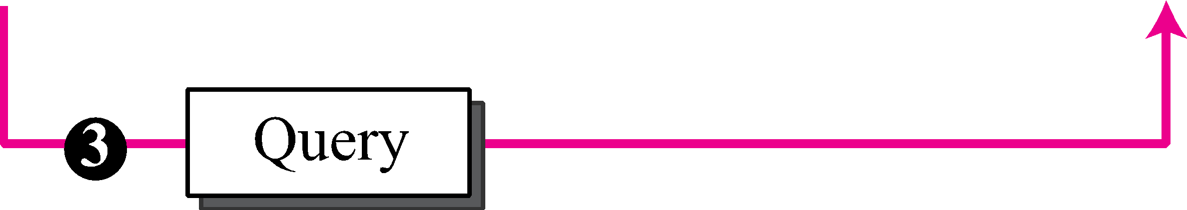
Domain Name System (DNS)
69.63. 176.13
Facebook
https://www.myip.com/

Slide 29
Domain Name System (DNS)
Need for DNS:
To identify an entity, TCP/IP protocols use the IP address, which uniquely identifies the connection of a host to the Internet. However, people prefer to use names instead of numeric addresses. Therefore, we need a system that can map a name to an address or an address to a name. (Map IP address with Domain Names)
Name Space:
To be unambiguous, the names assigned to machines must be carefully selected from a name space with complete control over the binding between the names and IP addresses. In other words, the names must be unique because the addresses are unique.
A name space that maps each address to a unique name can be organized in two ways:
Flat or Hierarchical.

Slide 30
Domain Name System (DNS)
DNS can use the services of UDP using the well-known port 53
The DNS name space
Domain Resource records
Name servers
Real time example: Phone Book. We cant remember phone numbers but by person names we can remember.
Ex: 3.1.234.34
cricinfo ip address (for cricket lovers)

Slide 31
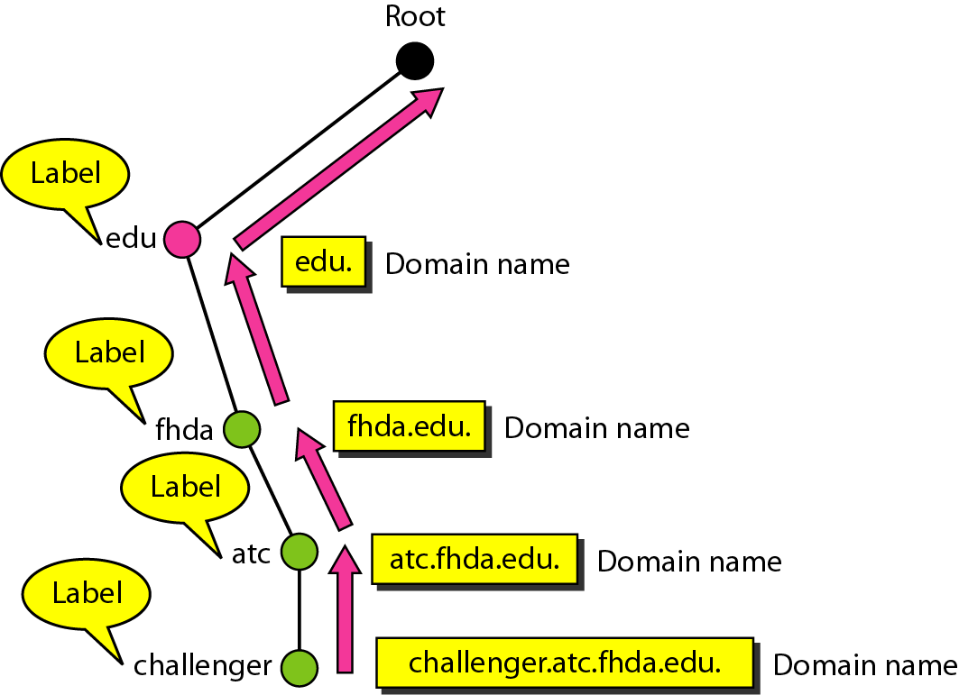
Domain names and labels
Server
Figure : Domain names and labels
Role of Cache is to store web pages and taken care by ISP

Slide 32
The DNS process
A browser, application or device called the DNS client, issues a DNS request or DNS address lookup, providing a hostname such as “example.com”.
The request is received by a DNS resolver, which is responsible for finding the correct IP address for that hostname. The DNS resolver looks for a DNS name server that holds the IP address for the hostname in the DNS request.
The resolver starts from the Internet’s root DNS server, moving down the hierarchy to Top Level Domain (TLD) DNS servers (“.com” in this case), down to the name server responsible for the specific domain “example.com”.
When the resolver reaches the authoritative DNS name server for “example.com”, it receives the IP address and other relevant details, and returns it to the DNS client. The DNS request is now resolved.
The DNS client device can connect to the server directly using the correct IP address.
,

Slide 33
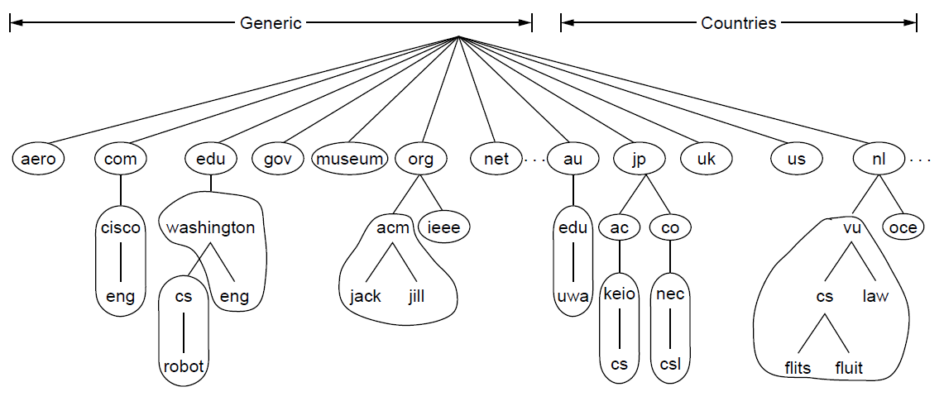
Part of the DNS name space divided into zones
Figure : Part of the DNS name space divided into zones (which are circled).

Slide 34
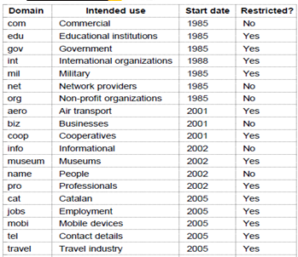
Generic top-level domains
Figure : Generic top-level domains

Slide 35
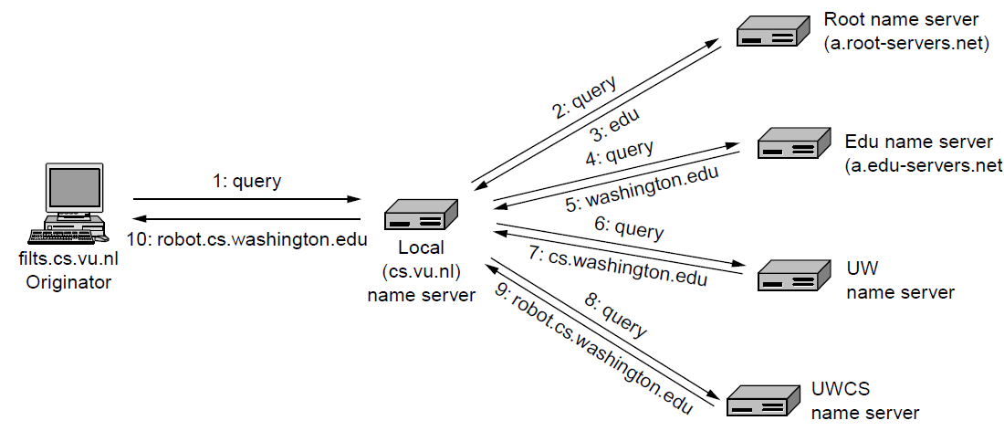
Example of a resolver looking up a remote name in 10 steps
Top level Domain server
Local cache/ DNS resolver
Actual IP addresses present in Autoreactive severs
Figure : Example of a resolver looking up a remote name in 10 steps

Slide 36
Resolution
Mapping a name to an address or an address to a name is called name-address resolution
Resolutions can be of two types
1. Recursive Resolution
2. Iterative Resolution

Slide 37
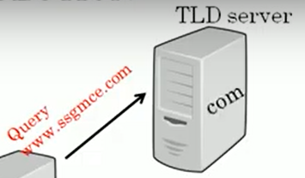
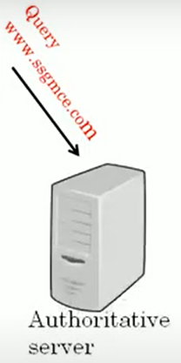
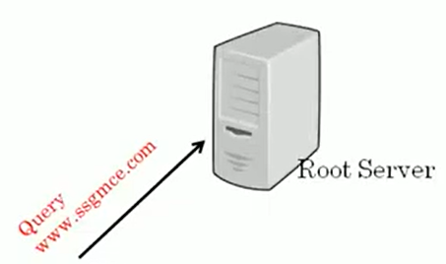
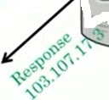

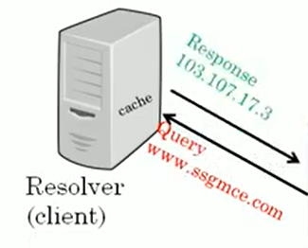
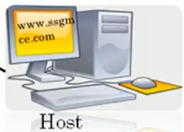
Recursive Resolution (IP Address should take from Root Server)
5. Root Server forward Query to Top Level Domain server i.e. .com server
Top Level Domain Server
4. If IP add not found, Resolver will forward .com Query to Root server
6. This AS contain mapping table which converts domain name into IP address
ssgmce.com
3. If It finds IP address, send IP address back to the host called caching
DNS
1. Host want to access website from some server like www.ssgmce.com. So host will need IP address.
2. Host send Query Message to DNS resolver. Will search for corresponding IP address into its own cache memory.
Figure : Recursive resolution

Slide 38
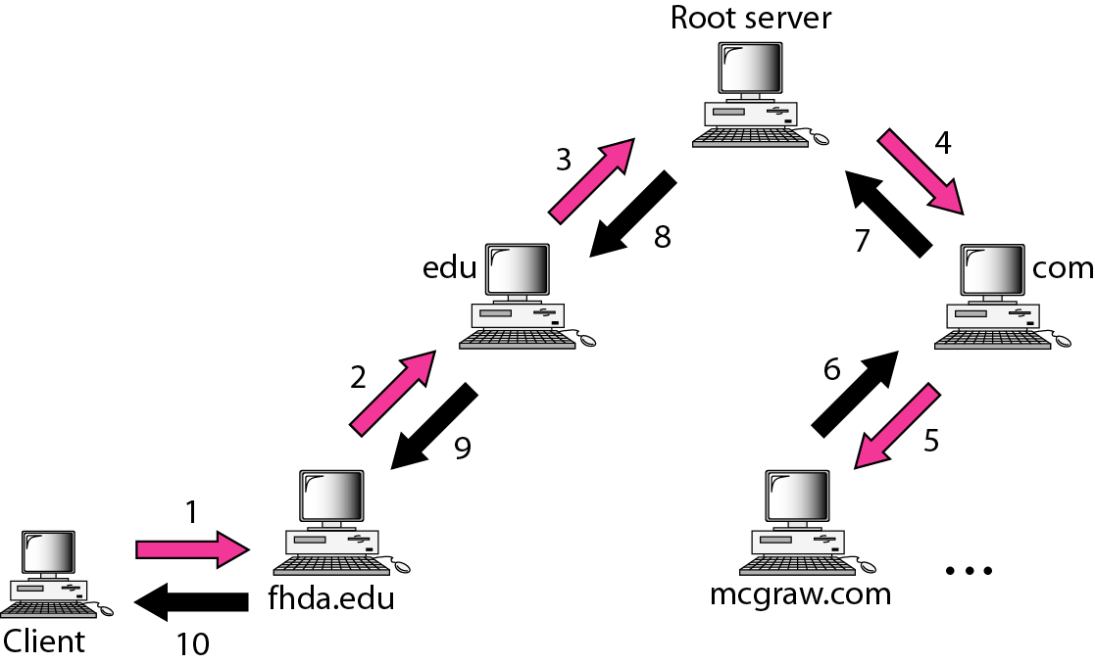
Recursive Resolution (Extra)
Mapping a name to an address or an address to a name is called name-address resolution
Figure : Recursive resolution

Slide 39
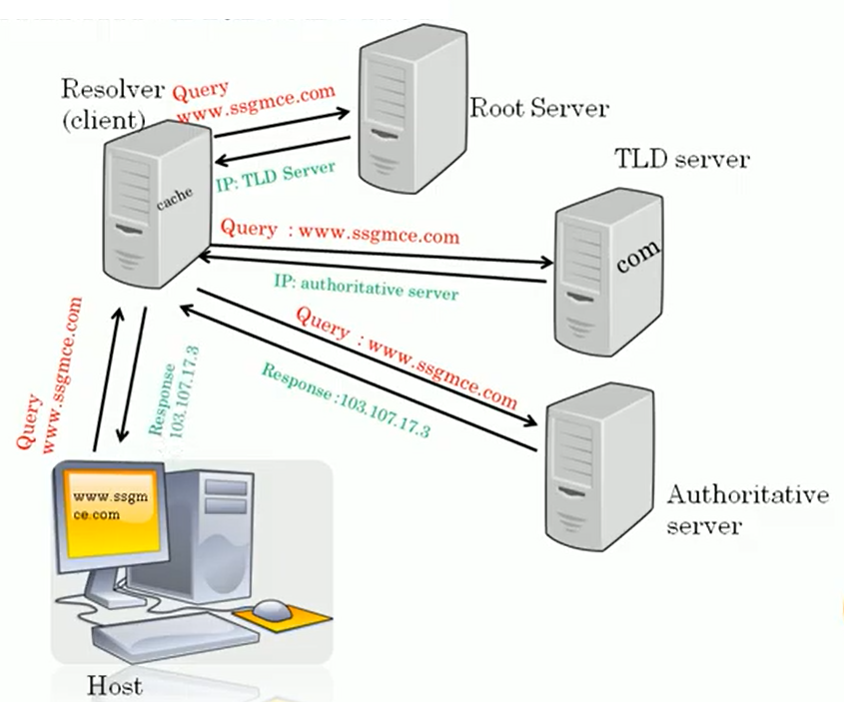
Iterative Resolution
In this, resolver has to send repeatedly query message to the different servers. Hence called as IR
Top Level Domain
Figure : Iterative resolution

Slide 40
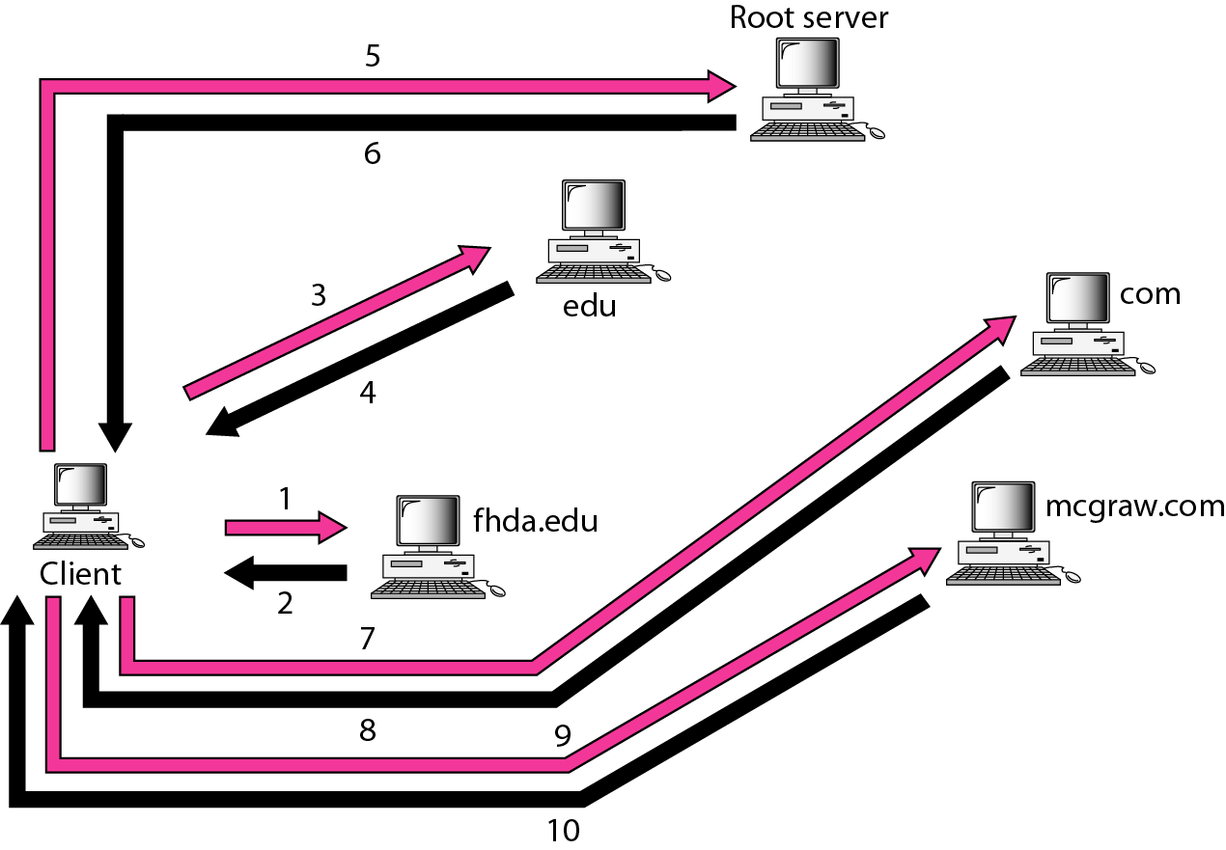
Iterative resolution (Extra)
Figure : Iterative resolution

Slide 41
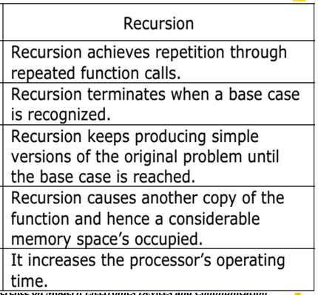
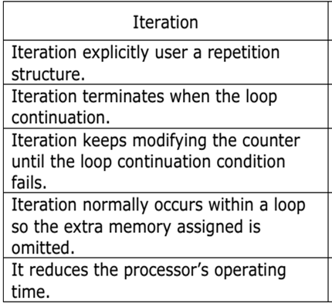
Difference Between Recursive and Iterative Resolution

Slide 42
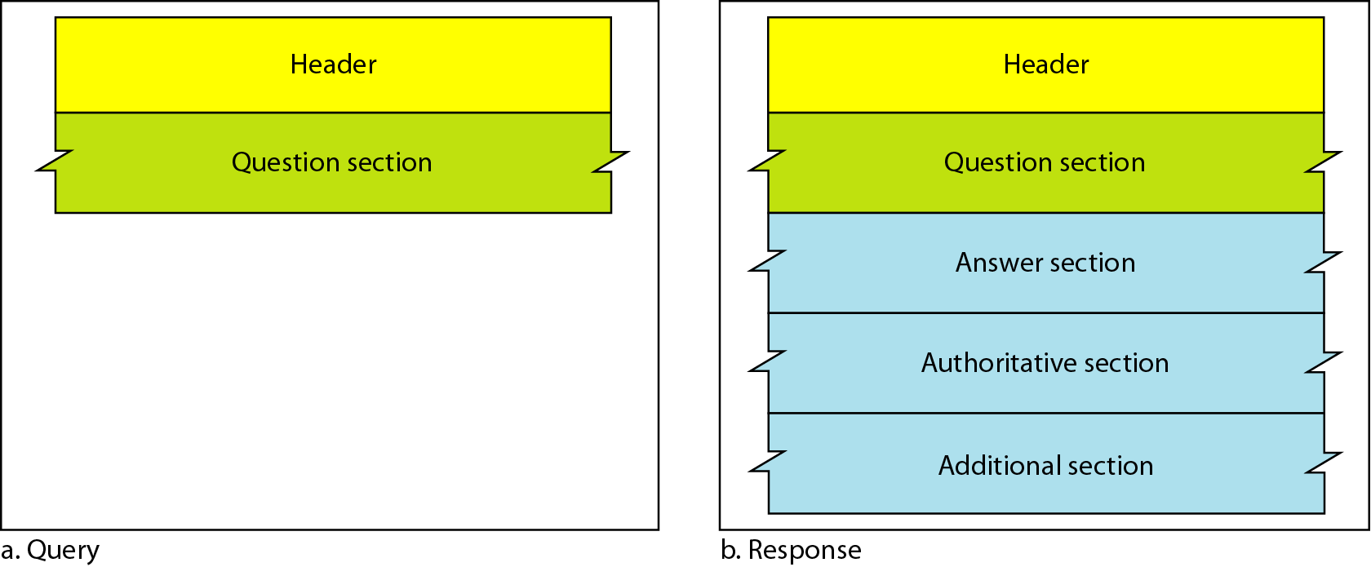
DNS Messages: 2 Types
The DNS protocol uses two types of DNS messages : 1. Query 2. Response
Both types have the same format. The query and Response message consists of:
Figure : DNS query and response messages

Slide 43
Header Format
Both Query and Response messages have the same header format with some fields set to zero for the query messages. The header is of 12 bytes.
Identification: for matching response to queries
Flags: specifies the requested operation and a response code (0-Query Message and 1-Reply Message)
Questions: count of entries in the queries section
Answer RRs: count of entries in the answers section (RR stands for “resource record”)
Authority RRs: count of entries in the authority section
Additional RRs: count of entries in the additional section
Queries: queries data

Slide 44
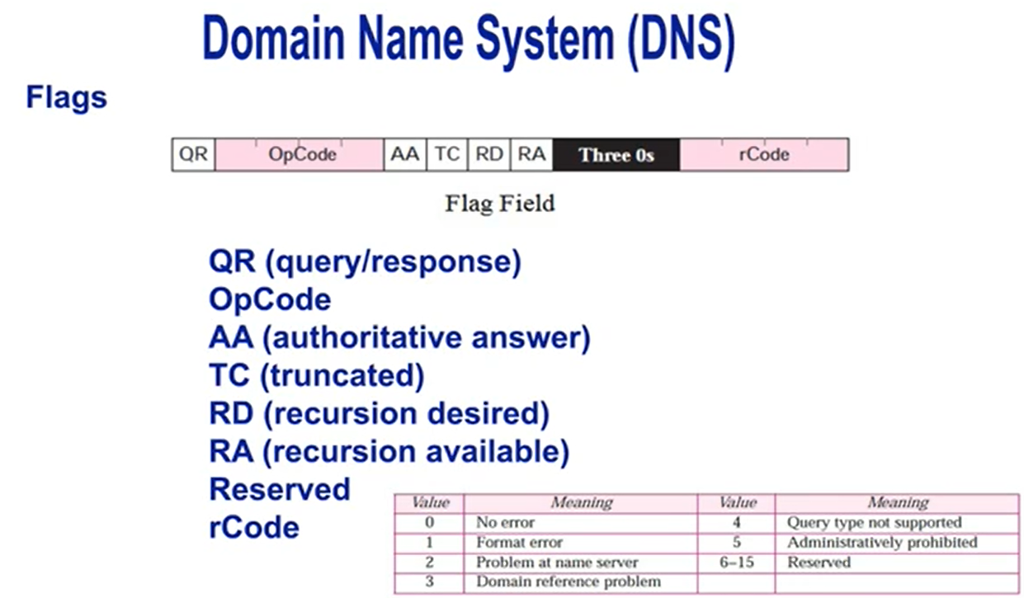
Extra

Slide 45
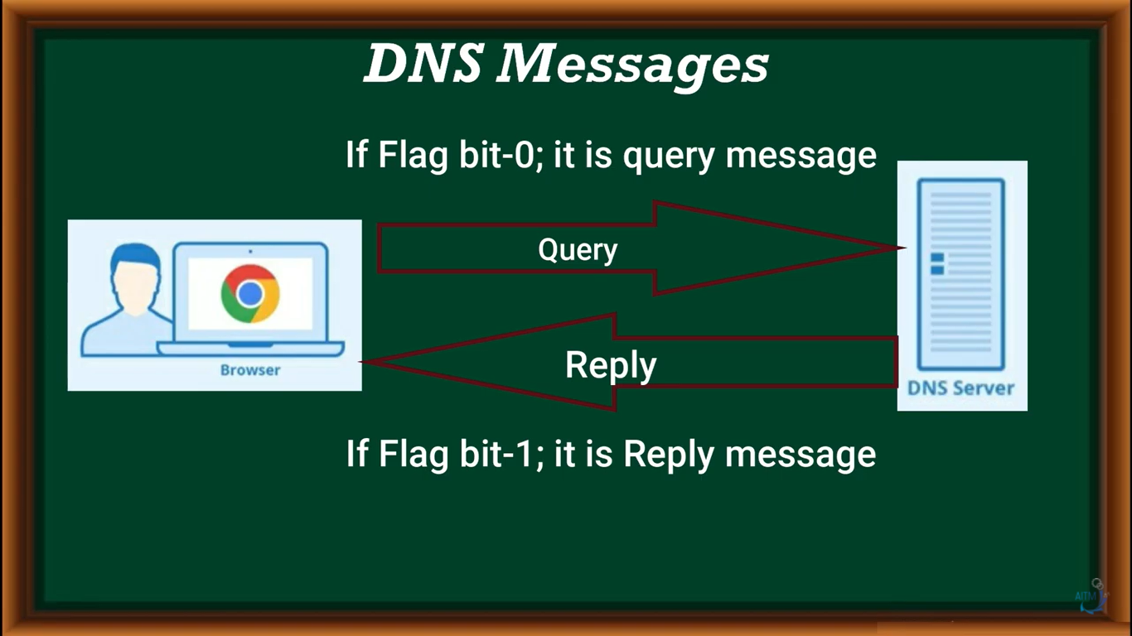

Slide 46
Flag Bits (Extra):
A brief description of each flag subfield follows.
a. QR (query/response): This is a 1-bit subfield that defines the type of message. If it is 0, the message is a query. If it is 1, the message is a response.
b. OpCode: This is a 4-bit subfield that defines the type of query or response (0 if standard, 1 if inverse, and 2 if a server status request).
c. AA (authoritative answer): This is a 1-bit subfield. When it is set (value of 1)it means that the name server is an authoritative server. It is used only in a response message.
d. TC (truncated): This is a 1-bit subfield. When it is set (value of 1), it means that the response was more than 512 bytes and truncated to 512. It is used when DNS uses the services of UDP (see Section 19.8 on Encapsulation).
e. RD (recursion desired): This is a 1-bit subfield. When it is set (value of 1) it means the client desires a recursive answer. It is set in the query message and repeated in the response message.
f. RA (recursion available): This is a 1-bit subfield. When it is set in the response, it means that a recursive response is available. It is set only in the response message.
g. Reserved: This is a 3-bit subfield set to 000.
h. rCode: This is a 4-bit field that shows the status of the error in the response.

Slide 47
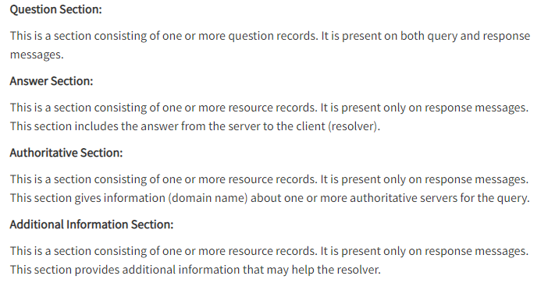
Header Format (Extra) cont

Slide 48
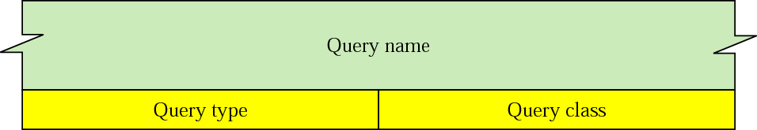
Types of records in DNS: Extra
DNS records are instructions that live in authoritative DNS servers and provide information about a domain including what IP address is associated with that domain and how to handle requests for that domain.
Two types of records are used in DNS:
The Question Records are used in the question section of the query and response messages
The Resource Records are used in the answer, authoritative, and additional information sections of the response message.
Figure : 1. Question records

Slide 49
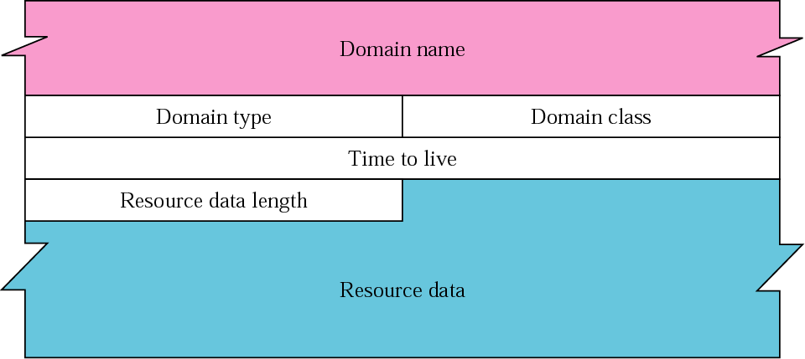
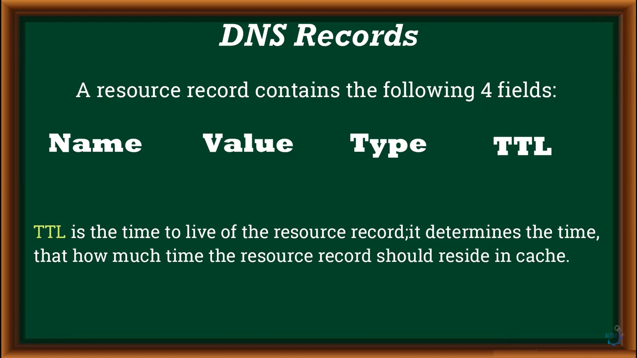
Resource Record Format: Extra
Figure : Resource Records

Slide 50
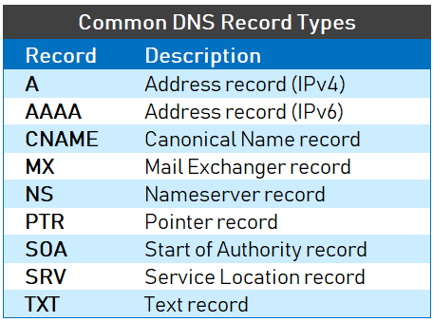
DNS Record: Extra

Slide 51
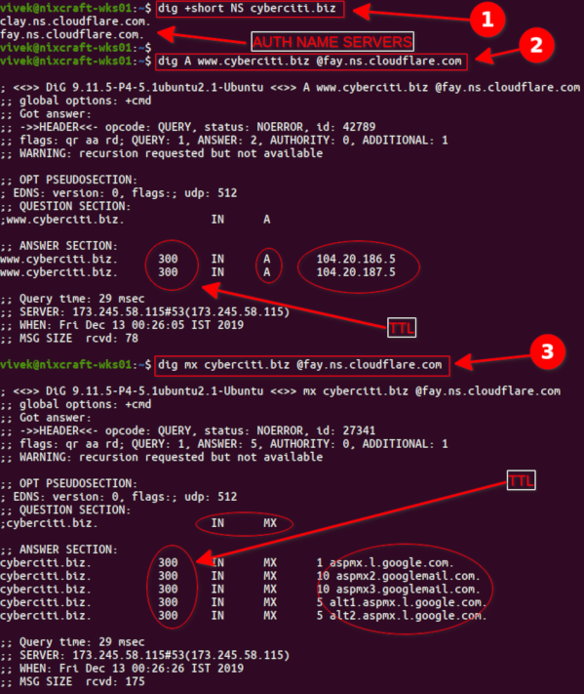
command: ipconfig/all
Extra

Slide 52
Dynamic Host Control Protocol
(DHCP)
https://www.youtube.com/watch?v=4pkDL1pgCgQ&t=122s

Slide 53
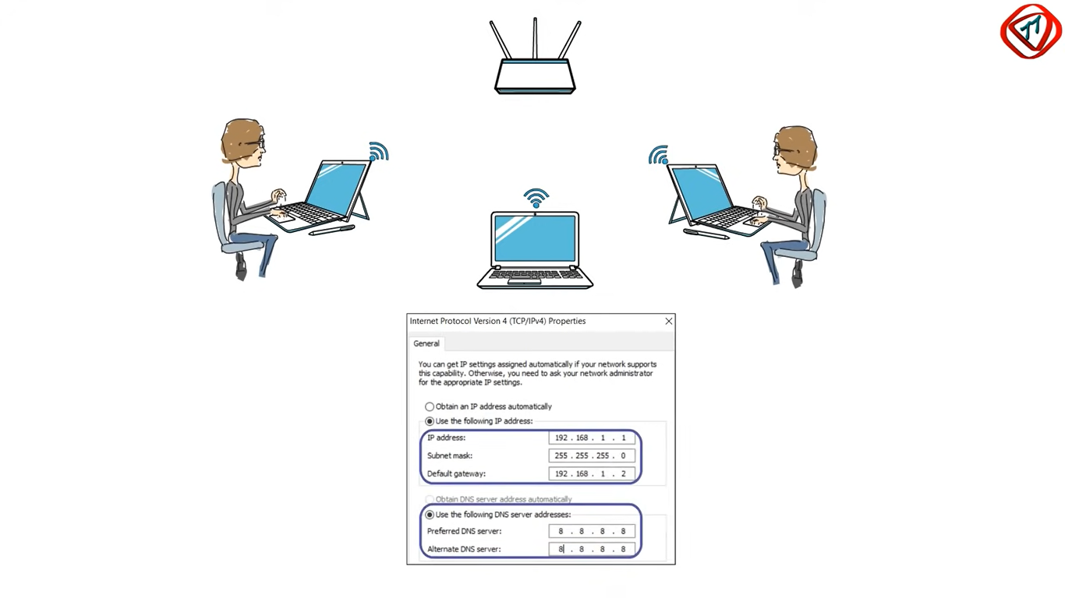
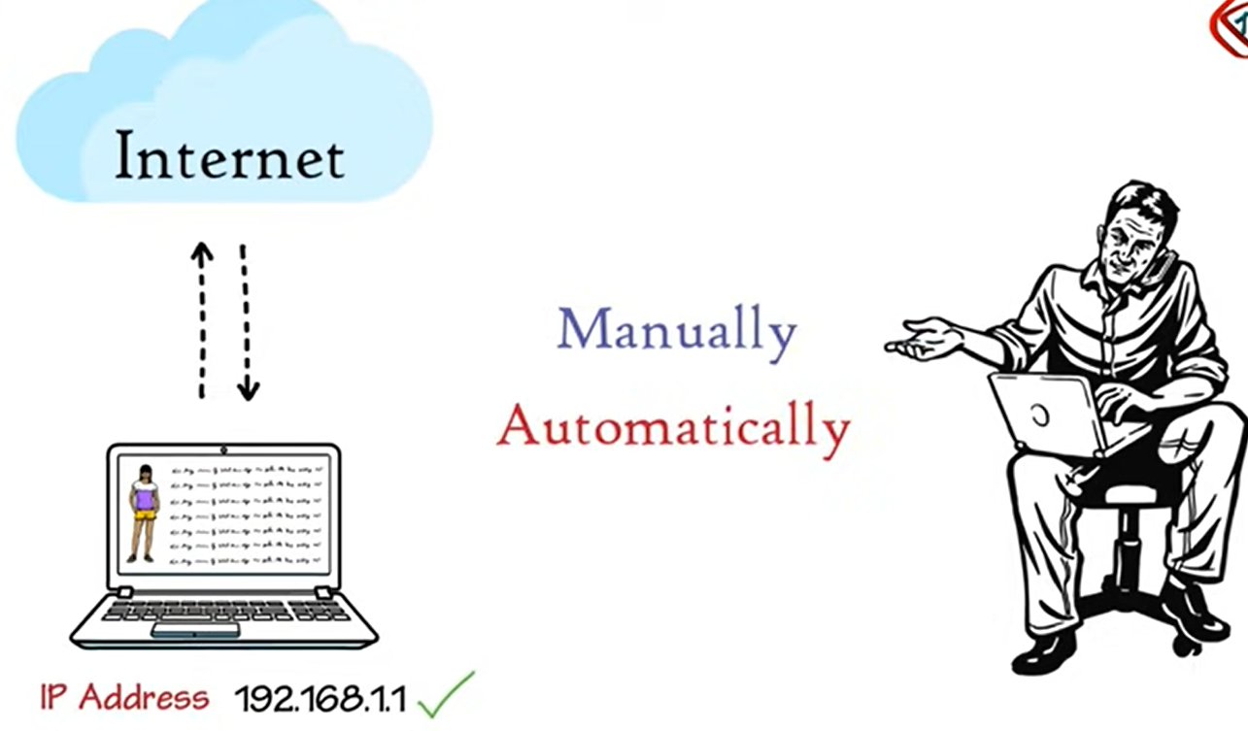
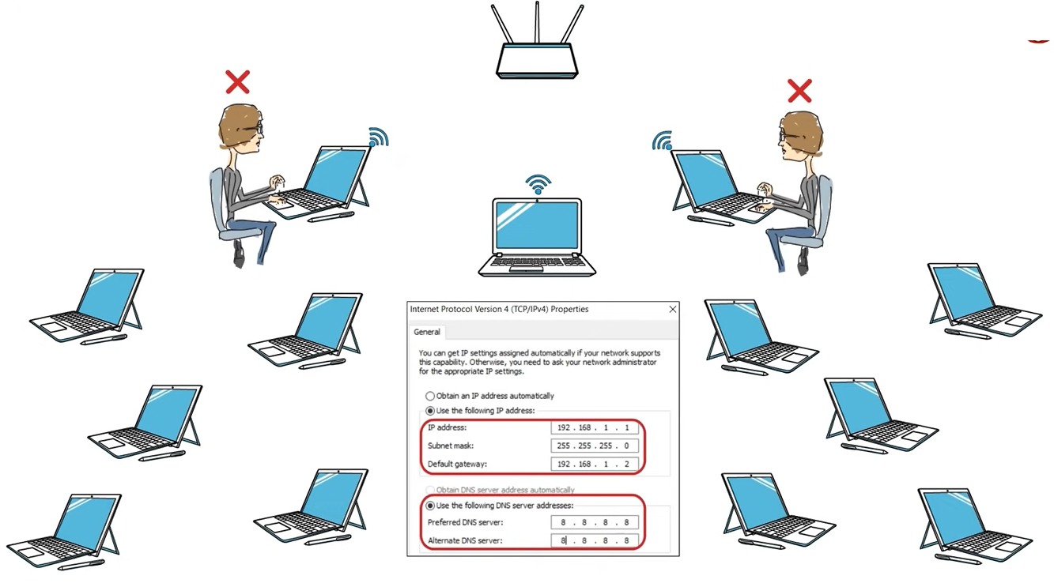
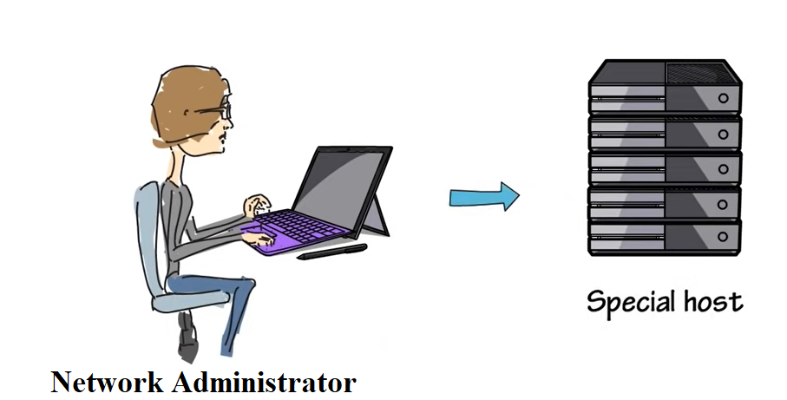
DHCP: Extra Information
Why IP Address is needed?
Manually given address as number of hosts are less
Special Host is called as DHCP Server
Dynamically given address as number of hosts are large

Slide 54


Dynamic Host Control Protocol (DHCP)
Each computer that uses the TCP/IP protocol suite needs to know its IP address. If the computer uses classless addressing or is a member of a subnet, it also needs to know its subnet mask.
Four pieces of information are normally needed:
1. The IP address of the computer
2. The subnet mask of the computer
3. The IP address of a router / Gateway
4. The IP address of a name server
These four pieces of information can be stored in a configuration file and accessed by the computer during the bootstrap process.
The DHCP client and server can either be on the same network or on different networks.

Slide 55

server Discovery,
IP lease Offer,
IP lease Request,
IP lease Acknowledgement.
The DORA process is a technique used by DHCP to dynamically assign IP addresses to any device, node or client machine over the Internet.

Slide 56



DHCP Client and Server on the Same Network
Figure : DHCP client and server on the same network

Slide 57


DHCP client and server on Two Different Networks
Helper
Figure : DHCP client and server on two different networks

Slide 58

Use of UDP ports in DHCP
Why UDP?
Fast protocol and used in real time
Figure : Use of UDP ports in DHCP

Slide 59



DHCP Packet / Message Format
Figure : DHCP packet format

Slide 60


DHCP Packet / Message Format
Operation-
Hardware Type-For Ethernet set to 1
H/W length- for Ethernet it is set to 1 (MAC Address)
Hops: Number of routers in between Client and Server.
Transaction ID-Random 32 bit number-0x458DE5A3 generated by client to match between replies and requests.
Flags: 16 bit.
Set to 1 if broadcast
Set to 0 if unicast
CIP add: Current client IP address
YIP Add: Address given by server to client
Figure : DHCP packet format

Slide 61

Extra Information about: boot file --- DHCP Packet / Message Format

Slide 62


DHCP Client Transition Diagram
Figure : DHCP client transition diagram

Slide 63

Exchanging Messages
Negative Acknowledgement (NACK)
Figure : DHCP message exchange diagram

Slide 64
SMTP: Simple Mail Transfer Protocol POP3: Post Office Protocol IMAP: Internet Message Access Protocol MIME: Multipurpose Internet Mail Extensions

Slide 65
SMTP: Simple Mail Transfer Protocol
Architecture and services
The user agent
Message formats
Message transfer
Final delivery

Slide 66
SMTP: Simple Mail Transfer Protocol (Port No. 25)
SMTP (Simple Mail Transfer Protocol) is a TCP/IP protocol used in sending e-mail.
SMTP is a push protocol and is used to send the mail
POP (post office protocol) or IMAP (internet message access protocol) are used to retrieve those emails at the receiver’s side.
SMTP is an application layer protocol.
The client who wants to send the mail opens a TCP connection to the SMTP server and then sends the mail across the connection.
The SMTP server is an always-on listening mode.
The SMTP process initiates a connection through port 25.
After successfully establishing a TCP connection the client process sends the mail instantly.

Slide 67


SMTP architecture and services
Figure : SMTP architecture and services

Slide 68
SMTP architecture and services
Figure : SMTP architecture and services

Slide 69
SMTP Architecture and Services
In the SMTP model user deals with the user agent (UA), for example, Microsoft Outlook, Netscape, Mozilla, etc.
In order to exchange the mail using TCP, MTA is used.
The user sending the mail doesn’t have to deal with MTA as it is the responsibility of the system admin to set up a local MTA.
The MTA maintains a small queue of mails so that it can schedule repeat delivery of mails in case the receiver is not available.
The MTA delivers the mail to the mailboxes and the information can later be downloaded by the user agents.
Figure : SMTP architecture and services

Slide 70


Simple Mail Transfer Protocol: POP3, IMAP, MIME
IMAP:
Internet Message Access Protocol
MIME:
Multipurpose Internet Mail Extensions
Figure : Format of an email

Slide 71
SMTP: Simple Mail Transfer Protocol
SENDING EMAIL:
Mail is sent by a series of request and response messages between the client and the server.
The message which is sent across consists of a header and a body.
A null line is used to terminate the mail header and everything after the null line is considered as the body of the message, which is a sequence of ASCII characters.
The message body contains the actual information read by the receipt.
RECEIVING EMAIL:
The user agent at the server-side checks the mailboxes at a particular time of intervals.
If any information is received, it informs the user about the mail.
When the user tries to read the mail it displays a list of emails with a short description of each mail in the mailbox.
By selecting any of the mail users can view its contents on the terminal.

Slide 72

SMTP
It pushes the message from the client to the server
On the other hand, the third stage needs a pull protocol
The client must pull messages from the server
The direction of the bulk data are from the server to the client.

Slide 73

SMTP : Simple Mail Transfer Protocol
SMTP is used two times, between the sender and the sender’s mail server and between the two mail servers
Figure : SMTP

Slide 74
Electronic mail : SMTP Summary
Uses TCP to reliably transfer email message from client to server (port 25)
Direct transfer: sending server to receiving server
Three phases of transfer
Handshaking (greeting)
Transfer of messages
Closure
Command/Response Interaction
commands: ASCII text
response: status code and phrase
Messages must be in 7-bit ASCII

Slide 75
Quiz
1. SMTP is a -------Protocol (Push/POP)
Push protocol
2. SMTP used to send the mail----True or False
True
3. POP and IMAP are -------protocol (Push/POP)
Pull
4. POP (post office protocol) or IMAP (internet message access protocol) are used to retrieve those emails at the receiver’s side. True or false
True
5. SMTP is an application layer protocol/Transport layer/Network Layer Protocol?
Application Layer Protocol
6. SMTP Port No? 25, 21, 20, 33
25
7. SMTP (Simple Mail Transfer Protocol) is a TCP/IP protocol used in sending and receiving e-mail. True/False
True.
8. MTA-----Abbreviation
Message Transfer Agent
9. UA-----Abbreviation
User Agent

Slide 76


https://www.youtube.com/watch?v=cjPVlxmf_Vk
Simple Mail Transfer Protocol: POP3, IMAP, MIME (Extra)
Client Based application:
MUA-Mail User Agent or client or sender
SMTP-To push mail from outlook to sender mail server
MSA-mail submission Agent (Error checking), Security checking
MTA-Mail Transfer Agent
MDA-Mail Delivery Agent
Sender
Receiver

Slide 77

Electronic Mail: Summary SMTP, POP3, IMAP (Extra)
Three major components
user agents
mail servers
simple mail transfer protocol: SMTP
User Agent
composing, editing, reading mail messages
e.g., Eudora, Outlook, elm, Mozilla Thunderbird
outgoing, incoming messages stored on server
Figure : SMTP working

Slide 78
Electronic Mail: Summary SMTP, POP3, IMAP (Extra)
Mail Servers
mailbox contains incoming messages for user
message queue of outgoing (to be sent) mail messages
SMTP protocol between mail servers to send email messages
client: sending mail server
“server”: receiving mail server
Figure : SMTP working

Slide 79

Scenario: Alice sends message to Bob
SMTP
SMTP
Alice
UA
Mail Server
UA
Bob
opens TCP connection with Bob’s mail server
mail server
1) Alice uses UA (User Agent) to compose message and “to” bob@someschool.edu
2) Alice’s UA sends message to her mail server; message placed in message queue
3) Client side of SMTP opens TCP connection with Bob’s mail server
4) SMTP client sends Alice’s message over the TCP connection
5) Bob’s mail server places the message in Bob’s mailbox
6) Bob invokes his user agent to read message

Slide 80
Comparison: HTTP and SMTP
SMTP requires message (header & body) to be in 7-bit ASCII
SMTP server uses CRLF. CRLF (Carriage Return Line Feed) indicates a new line, i.e. a Carriage Return immediately. CRLF to determine end of message.
Comparison with HTTP:
HTTP: Pull
SMTP: Push
Both have ASCII command/response interaction, status codes
HTTP: Each object encapsulated in its own response message
SMTP: Multiple objects sent in Multipart message

Slide 81

POP3 (Post Office Protocol) and IMAP4 (Internet Message Access Protocol)
IMAP4 is similar to POP3, but it has more features;
IMAP4 is more powerful and more complex.
POP3 is deficient in several ways. It does not allow the user to organize her mail on the server; the user cannot have different folders on the server.
In addition, POP3 does not allow the user to partially check the contents of the mail before downloading.

Slide 82
POP3 Protocol
POP3 is a one-way client-server protocol in which email is received and held on the email server. The "3" refers to the third version of the original POP protocol.
Thus, POP3 offers a means of downloading email from a server to the client so the recipient can view the email offline. POP3 can be thought of as a "store-and-forward" service.
Once the email is on the client, POP3 then deletes it from the server. With some implementations, users or an administrator can specify that mail be saved for some time
since POP3 is built into standard internet browsers, including Internet Explorer and Mozilla Thunderbird, users can check their email even without an email client.
POP3 ports
port 110: default, non-encrypted port; and
port 995: should be used when the user needs to connect using POP3 securely.

Slide 83
POP3 Protocol: Working
The server starts POP3 service by listening on TCP port 110.
When a client wishes to use POP3 for email retrieval, it establishes a TCP connection with the server host.
Authorization state: Once this connection is established, the POP3 server sends a greeting.
Transaction state: the client and server exchange commands and responses until the connection is either closed or aborted
Update state: It is entered when client gives QUIT command. The POP3 server releases any resources acquired during the transaction state, and says "goodbye," which is when the TCP connection is closed.
After the POP3 session enters the update state, the POP3 server deletes the message.

Slide 84
IMAP4 Protocol
Internet Message Access Protocol (IMAP) is an application layer protocol that operates as a contract for receiving emails from the mail server.
IMAP is an alternative email retrieval protocol.
IMAP allows the user to retain email on the server, where the email can be organized in folders.
Like POP3, IMAP is supported by all modern email clients and web servers.
Unlike POP3, IMAP synchronizes the email across multiple devices or clients, making it more suitable than POP3 when a user is working with many devices or wants to access email from multiple locations.
IMAP works on ports 143(non secured) and 993(secured).

Slide 85
IMAP4 Protocol
Features of IMAP :
It is capable of managing multiple mailboxes and organizing them into various categories.
Provides adding of message flags to keep track of which messages are being seen.
It is capable of deciding whether to retrieve email from a mail server before downloading.
It makes it easy to download media when multiple files are attached.

Slide 86
IMAP4 Protocol
Advantages :
It offers synchronization across all the maintained sessions by the user.
It provides security over POP3 protocol as the email only exists on the IMAP server.
Users have remote access to all the contents.
It offers easy migration between the devices as it is synchronized by a centralized server.
There is no need to physically allocate any storage to save contents.
Disadvantages :
IMAP is complex to maintain.
Emails of the user are only available when there is an internet connection.
It is slower to load messages.
Some emails don’t support IMAP which makes it difficult to manage.
Many browser-based solutions are unavailable due to not support of IMAP.

Slide 87
IMAP4 provides the following extra functions
A user can check the e-mail header prior to downloading.
A user can search the contents of the e-mail for a specific string of characters prior to downloading.
A user can partially download e-mail. This is especially useful if bandwidth is limited and the e-mail contains multimedia with high bandwidth requirements.
A user can create, delete, or rename mailboxes on the mail server.
A user can create a hierarchy of mailboxes in a folder for e-mail storage.

Slide 88

Comparison of POP3 and IMAP

Slide 89
Multipurpose Internet Mail Extensions (MIME)
Limitations of SMTP
SMTP has a very simple structure
It can only sends messages in NVT 7-bit ASCII format.
It cannot be used for languages that do not support 7-bit ASCII format such as French, German, Russian, Chinese and Japanese, etc. so it cannot be transmitted using SMTP.
It cannot be used to send binary files or video or audio data.
So, in order to make SMTP more broad, MIME is used

Slide 90

MIME
Working of MIME –
MIME transforms non-ASCII data at the sender side to NVT 7-bit data and delivers it to the client SMTP.
The message on the receiver side is transferred back to the original data.
As well as we can send video and audio data using MIME as it transfers them also in 7-bit ASCII data.

Slide 91
MIME
Features of MIME –
It is able to send multiple attachments with a single message.
Unlimited message length.
Binary attachments (executables, images, audio, or video files) may be divided if needed.
MIME provided support for varying content types and multi-part messages.
MIME header is basically inserted at the beginning of any e-mail transfer.
MIME header is added to the SMTP header and it provides additional information.

Slide 92
MIME Header: EXTRA
MIME Header:
It is added to the original e-mail header section to define transformation. There are five headers that we add to the original header:
MIME-Version – Defines the version of the MIME protocol. It must have the parameter Value 1.0, which indicates that message is formatted using MIME.
Content-Type – Type of data used in the body of the message. They are of different types like text data (plain, HTML), audio content, or video content.
Content-Type Encoding – It defines the method used for encoding the message. Like 7-bit encoding, 8-bit encoding, etc.
Content Id – It is used for uniquely identifying the message.
Content description – It defines whether the body is actually an image, video, or audio.

Slide 93

Data Types and Subtypes in MIME: EXTRA

Slide 94
FTP: File Transfer Protocol TFTP: Trivial File Transfer Protocol
TELNET : TErminaL NETwork
SNMP: Simple Network Management Protocol

Slide 95
File Transfer Protocol (FTP)
FTP (File Transfer Protocol) is a standard network protocol used for the transfer of files from one host to another over a TCP-based network, such as the Internet.
FTP works by opening two connections that link the computers trying to communicate with each other.
One connection is designated for the commands and replies that get sent between the two clients, and the other channel handles the transfer of data
FTP transfers the data effectively even if the systems involved in connection are heterogeneous systems, i.e. they differ in operating systems, directories, structures, character sets, etc
FTP can transfer ASCII, EBCDIC, or image files

Slide 96

File Transfer Protocol (FTP)
Port 21
Port 20
FTP uses two well-known TCP ports: Port 21 is used for the control connection,
and port 20 is used for the data connection

Slide 97
File Transfer Protocol (FTP)
File Transfer Protocol (FTP) is the standard mechanism provided by TCP/IP for copying a file from one host to another.
Although transferring files from one system to another seems simple and straightforward.
For example, two systems may use different file name conventions.
Two systems may have different ways to represent text and data.
Two systems may have different directory structures.
All of these problems have been solved by FTP in a very simple and smart approach.

Slide 98

FTP Connection
1. Control Connection: For sending control information like user identification, password, commands to change the remote directory, commands to retrieve and store files, etc., FTP makes use of a control connection. The control connection is initiated on port number 21.
2. Data connection: For sending the actual file, FTP makes use of a data connection. A data connection is initiated on port number 20. FTP sends the control information out-of-band as it uses a separate control connection. Some protocols send their request and response header lines and the data in the same TCP connection. For this reason, they are said to send their control information in-band. HTTP and SMTP are such examples.

Slide 99
FTP Session and FTP Client
FTP Session
When an FTP session is started between a client and a server, the client initiates a control TCP connection with the server side.
The client sends control information over this.
When the server receives this, it initiates a data connection to the client side.
Only one file can be sent over one data connection.
But the control connection remains active throughout the user session.
FTP needs to maintain a state about its user throughout the session.
FTP Clients
FTP works on a client-server model.
The FTP client is a program that runs on the user’s computer to enable the user to talk to and get files from remote computers.
It is a set of commands that establishes the connection between two hosts, helps to transfer the files, and then closes the connection.

Slide 100
Characteristics of FTP
Characteristics of FTP
FTP uses TCP as a transport layer protocol.
It is good for simple file transfers, such as during boot time.
Errors in the transmission (lost packets, checksum errors) must be handled by the TFTP server.
It uses only one connection through well-known port 69.
TFTP uses a simple lock-step protocol (each data packet needs to be acknowledged). Thus the throughput is limited.

Slide 101
Creating the Control and Data Connection (Extra Information)
Advantages of FTP
Speed is one of the advantages of FTP(File Transfer Protocol).
File sharing also comes in the category of advantages of FTP in this between two machines files can be shared on the network.
Efficiency is more in FTP.
Disadvantages of FTP
File size limit is the drawback of FTP only 2 GB size files can be transferred.
Multiple receivers are not supported by the FTP.
FTP does not encrypt the data this is one of the biggest drawbacks of FTP.
FTP is unsecured we use login IDs and passwords making it secure but they can be attacked by hackers.

Slide 102

File Management Commands: Extra

Slide 103

File Transfer Commands: Extra

Slide 104

Responses: Extra

Slide 105






Example FTP for retrieving a list of items in a directory; Extra
This protocol when used over PORT 8888 makes possible the transmission of a datagram message from one computer to an application running in another computer.

Slide 106
Using FTP for retrieving a list of items in a directory: Extra
1. After the control connection to port 21 is created, the FTP server sends the 220 (service ready) response on the control connection.
2. The client sends the USER command.
3. The server responds with 331 (user name is OK, password is required).
4. The client sends the PASS command.
5. The server responds with 230 (user login is OK).
6. The client issues a passive open on an ephemeral port for the data connection and sends the PORT command (over the control connection) to give this port number to the server.
7. The server does not open the connection at this time, but it prepares itself for issuing an active open on the data connection between port 20 (server side) and the ephemeral port received from the client. It sends response 150 (data connection will open shortly).

Slide 107
Using FTP for retrieving a list of items in a directory: Extra
8. The client sends the LIST message.
9. Now the server responds with 125 and opens the data connection.
10. The server then sends the list of the files or directories (as a file) on the data connection.
When the whole list (file) is sent, the server responds with 226 (closing data connection) over the control connection.
11. The client now has two choices. It can use the QUIT command to request the closing of the
control connection or it can send another command to start another activity (and eventually open another data connection). In our example, the client sends a QUIT command.
12. After receiving the QUIT command, the server responds with 221 (service closing) and then closes the control connection.

Slide 108

Trivial File Transfer Protocol (TFTP)
Trivial meaning: not worth or little importance
Port 69

Slide 109
Trivial File Transfer Protocol (TFTP)
TFTP is good for simple file transfers, such as during boot time.
It uses UDP and basic IP and can operate out of ROM.
It uses the well-known Port 69.
TFTP can read or write a file for the client.
Reading means copying a file from the server site to the client site.
Writing means copying a file from the client site to the server site.

Slide 110
Trivial File Transfer Protocol (TFTP)
There are occasions when we need to simply copy a file without the need for all of the features of the FTP protocol. For example, when a diskless workstation or a router is booted, we need to download the bootstrap and configuration files.
Here we do not need all of the sophistication provided in FTP. We just need a protocol that quickly copies the files.
Trivial File Transfer Protocol (TFTP) is designed for these types of file transfer.
It is so simple that the software package can fit into the read-only memory of a diskless workstation.

Slide 111

TFTP Uses 5 types of Message categories:
Read Request (RRQ),
Write Request (WRQ),
Data (DATA),
Acknowledgment (ACK)
Error (ERROR).

Slide 112

RRQ format: Extra
Mode: defines the type of the file transferred
“net ascii” for an ASCII file;
“octet” for a binary file
Ascii--American Standard Code for Information Interchange

Slide 113


WRQ format and Data format: Extra
WRQ format
Data format

Slide 114


ACK and Error format: Extra
ACK format
Error format

Slide 115
Difference Between FTP and TFTP
FTP | TFTP
FTP uses two connection | TFTP uses one connection
Provide many commands | Provide only five commands
Uses TCP | Uses UDP
Client must login to server | No login procedure
Allow for user authentication | TFTP does not allow for user authentication
FTP provide reliable service | Unreliable
21- control, 20-data | Port 69

Slide 116
TELNET
(TErminaL NETwork)
https://www.youtube.com/watch?v=2JjILZPOC5g

Slide 117
TELNET Port 23
TELNET stands for Teletype Network.
It is a type of protocol that enables one computer to connect to the local computer.
It is used as a standard TCP/IP protocol for virtual terminal service which is provided by ISO.
The computer which starts the connection is known as the local computer.
The computer which is being connected to i.e. which accepts the connection known as the remote computer.
During telnet operation, whatever is being performed on the remote computer will be displayed by the local computer.
The local computer uses a telnet client program and the remote computers use a telnet server program.

Slide 118
Local Login
Logging
The logging process can be further categorized into two parts:
Local Login
Remote Login
1. Local Login: Whenever a user logs into its local system, it is known as local login.
The Procedure of Local Login
Keystrokes are accepted by the terminal driver when the user types at the terminal.
Terminal Driver passes these characters to OS.
Now, OS validates the combination of characters and opens the required application.

Slide 119
Remote Login
Remote Login: Remote Login is a process in which users can log in to a remote site i.e. computer and use services that are available on the remote computer.
With the help of remote login, a user is able to understand the result of transferring the result of processing from the remote computer to the local computer.
The Procedure of Remote Login
When the user types something on the local computer, the local operating system accepts the character.
The local computer does not interpret the characters, it will send them to the TELNET client.

Slide 120
Remote Login
TELNET client transforms these characters to a universal character set called Network Virtual Terminal (NVT) characters and it will pass them to the local TCP/IP protocol Stack.
Commands or text which are in the form of NVT, travel through the Internet and it will arrive at the TCP/IP stack at the remote computer.
Characters are then delivered to the operating system and later on passed to the TELNET server.
Then TELNET server changes those characters to characters that can be understandable by a remote computer.
The remote operating system receives characters from a pseudo-terminal driver, which is a piece of software that pretends that characters are coming from a terminal.
The operating system then passes the character to the appropriate application program.

Slide 121

Remote Login

Slide 122

Concept of Network Virtual Terminal:Extra
Intermediate representation of a generic terminal
Provides a standard language for communication of terminal control functions

Slide 123
Command Structure: Extra
All TELNET commands and data flow through the same TCP connection.
Commands start with a special character called the Interpret as Command escape character
The IAC code is 255.
If a 255 is sent as data - it must be followed by another 255.
If IAC is found and the next byte is IAC
a single byte is presented to application/terminal
If IAC is followed by any other code
the TELNET layer interprets this as a command.

Slide 124
Playing with TELNET: Extra
You can use the telnet program to play with the TELNET protocol.
telnet is a generic TCP client.
Sends whatever you type to the TCP socket.
Prints whatever comes back through the TCP socket
Useful for testing TCP servers (ASCII based protocols).
Many Unix systems have these servers running (by default):
echo port 7 discard port 9
Daytime port 13 chargen (Character Generator) port 19

Slide 125
TELNET
Advantages of Telnet
It provides remote access to someone’s computer system.
Telnet allows the user for more access with fewer problems in data transmission.
Telnet saves a lot of time.
The oldest system can be connected to a newer system with telnet having different operating systems.
Disadvantages of Telnet
As it is somehow complex, it becomes difficult to beginners in understanding.
Data is sent here in form of plain text, that’s why it is not so secured.
Some capabilities are disabled because of not proper interlinking of the remote and local devices.

Slide 126
Simple Network Management Protocol SNMP
Port Number– Server-161 and Client-162
https://www.youtube.com/watch?v=Lq7j-QipNrI
https://www.youtube.com/watch?v=2IXP0TkwNJU

Slide 127
Simple Network Management Protocol: SNMP concept
Simple Network Management Protocol (SNMP) is an internet standard protocol used to monitor and manage network devices connected over an IP. SNMP is used for communication between routers, switches, firewalls, load balancers, servers, CCTV cameras, and wireless devices.
SNMP is an application layer protocol that uses UDP port number 161/162.SNMP is used to monitor the network, detect network faults, and sometimes even used to configure remote devices.

Slide 128
SNMP Components
SNMP Manager – It is a centralized system used to monitor network. It is also known as Network Management Station (NMS)
SNMP agent – It is a software management software module installed on a managed device. Managed devices can be network devices like PC, routers, switches, servers, etc.
Management Information Base – MIB consists of information on resources that are to be managed. This information is organized hierarchically. It consists of objects instances which are essentially variables.

Slide 129
SNMP
Advantages of SNMP:
1. It is simple to implement.
2. Agents are widely implemented.
3. Agent level overhead is minimal.
4. It is robust and extensible.
5. Polling approach is good for LAN based managed object.
6. It offers the best direct manager agent interface.
7. SNMP meet a critical need.

Slide 130
SNMP
Limitation of SNMP:
1. It is too simple and does not scale well.
2. There is no object orietned data view.
3. It has no standard control definition.
4. It has many implementation specific (private MIB) extensions.
5. It has high communication overhead due to polling

Slide 131

Port numbers for SNMP
Port 58000 uses the Transmission Control Protocol.
TCP port 61150 uses the Transmission Control Protocol.
https://www.adminsub.net/tcp-udp-port-finder/61150

Slide 132
References
Text Books:
Behrouz A. Forouzan, ‘Data Communications and Networking’, 5th Edition, McGraw-Hill Publishing Company, ISBN 978-0-07-337622-6
Tanenbaum A. S., ‘Computer Networks’, Pearson Education , 5th Edition, ISBN-978-0-13-212695-3
Reference Books:
James F. Kurose and Keith W Ross ‘Computer Networking, A Top-Down Approach’, 5th Edition, Pearson Education, ISBN- 978-81-317-9054-0
W. Richard Stevens, Unix Network Programming, The Sockets Networking API, Vol 1, 3rd Edition, PHI Learning Pvt. Ltd.
Supplementary Reading:
William Stallings, ‘Data and Computer Communications’, 6th Edition, Prentice Hall of India Pvt.
Web Resources:
https://nptel.ac.in/courses/106/105/106105080/
https://nptel.ac.in/courses/106/106/106106091/
Web links:
https://nptel.ac.in/courses/106/105/106105081/
https://nptel.ac.in/courses/106/105/106105183/
https://ocw.mit.edu/courses/electrical-engineering-and-computer-science/6-829-computer-networks-fall-2002/index.htm
MOOCs:
https://www.coursera.org/learn/computer-networking
https://www.edx.org/course/introduction-to-networking?index=product&queryID=0befdc538866babf2facfdc2dce06204&position=1

Slide 133
Thank You

